Slide 1
Secure Data Hiding in Images using Python
Image Steganography with Encryption
Presented By: Sanket Shinde
Student Name : Sanket Shinde
College Name & Department : MIT-WPU M.Tech Cybersecurity

Slide 2
OUTLINE
Problem Statement
Technology used
Wow factor
End users
Result
Conclusion
Git-hub Link
Future scope

Slide 3
INTRODUCTION
Definition: Steganography is the technique of hiding secret information within digital media, such as images.
Use case: Protecting sensitive data from unauthorized access.
Unlike cryptography, steganography hides the existence of the message.

Slide 4
Problem Statement
Challenge: Secure communication over digital channels without detection.
Issues with Traditional Cryptography:
Encrypted messages can be intercepted and raise suspicion.
Requires secure key exchange mechanisms.
Proposed Solution: Combining steganography with encryption ensures:
Hidden data remains undetectable.
Even if detected, encrypted data prevents unauthorized access.

Slide 5
Technology used
1. Why Use Encryption?
Even if someone extracts hidden data, encryption ensures only authorized users can read it.We use Fernet encryption from the cryptography module.Fernet is a symmetric encryption method, ensuring both encryption and decryption use the same key.Provides confidentiality and integrity to the hidden message.
2. Encoding Process
Step 1: Select an image (PNG/JPG) as a cover medium.Step
2: Convert secret text to binary format.
Step 3: Encrypt text using Fernet encryption for added security.
Step 4: Hide encrypted binary data into pixel values using the Least Significant Bit (LSB) method.
Step 5: Save the modified image containing the hidden message.

Slide 6
Technology used
3. Decoding Process
Step 1: Load the steganographic image.
Step 2: Extract LSBs to retrieve the hidden binary data.
Step 3: Convert binary data back to characters.
Step 4: Decrypt the retrieved encrypted text using the provided decryption key.
Step 5: Display the original secret message
4. Least Significant Bit (LSB) Method
The LSB of each pixel component (Red, Green, Blue) is modified to store binary data.
Example:
Original pixel (R,G,B) = (10101100, 11010011, 10111010)
Modified pixel with hidden bit = (10101101, 11010010, 10111011)
Minor changes ensure image quality is maintained while storing the message

Slide 7
Technology used
5.Python Implementation Overview
Uses OpenCV for image handling.
Uses Tkinter for GUI interface.
Encrypts message with Fernet before hiding it.
Ensures only the correct decryption key reveals the message.
Extracts data using pixel traversal and bit manipulation techniques.

Slide 8
Wow factors
Invisible yet Secure: The message is hidden in plain sight within images.
Double Protection: Even if the message is found, encryption prevents unauthorized access.
User-Friendly Interface: Simple GUI for encoding and decoding messages.
Stealth Mode: No external noise or distortion makes the hidden data undetectable.
Copyable Encryption Key: Ensures users can easily save and retrieve their decryption key.
Real-World Applications: Used in cybersecurity, intelligence, and digital forensics.

Slide 9
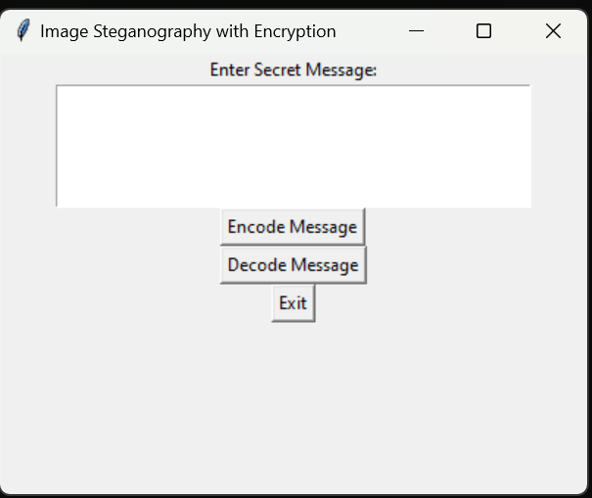
End users
Encoding:
Input text to hide.
Select an image.
Save encrypted image.
Displays encryption key (copyable for future use).
Decoding:
Select image with hidden data.
Enter encryption key.
Display decrypted message.

Slide 10
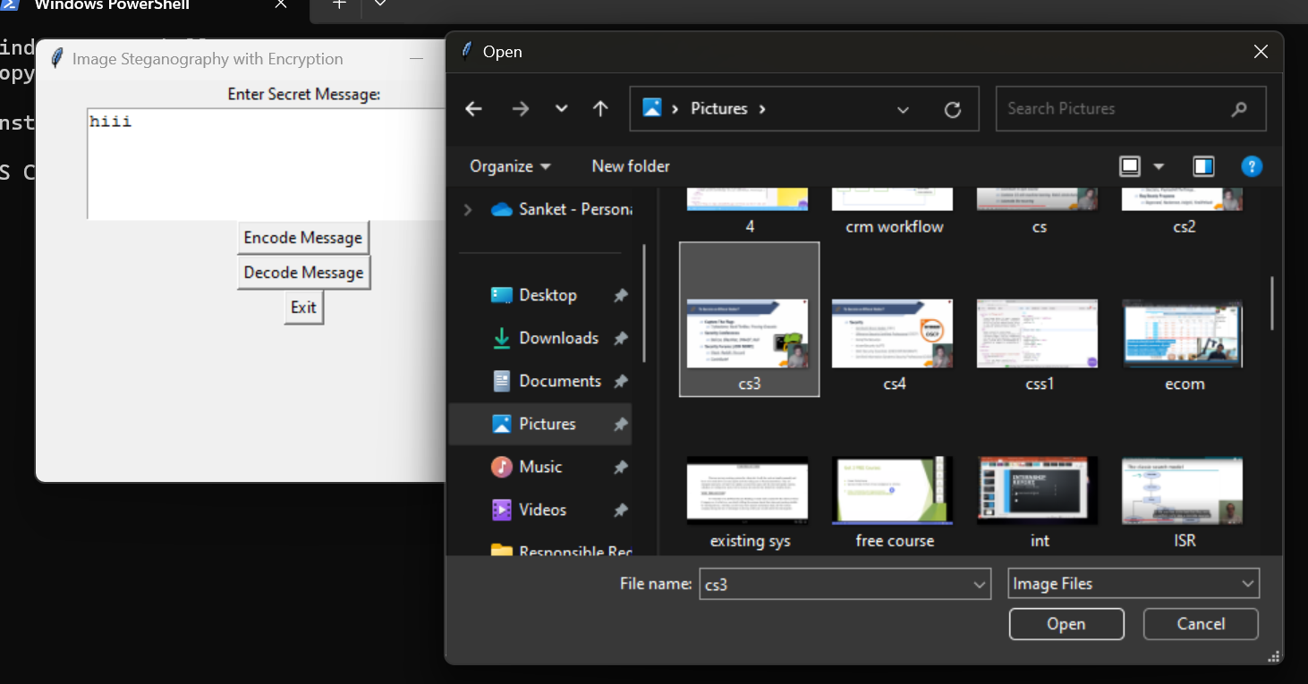
Results

Slide 11
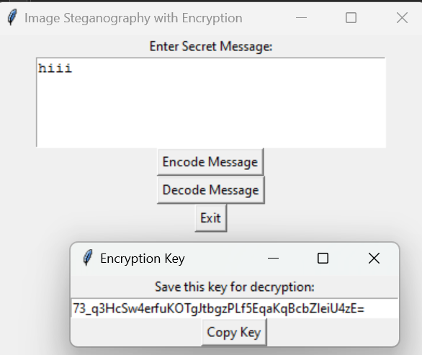
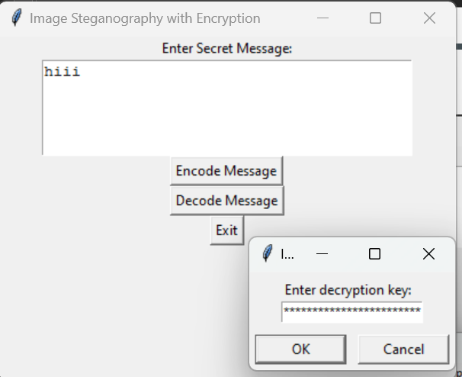
Results

Slide 12
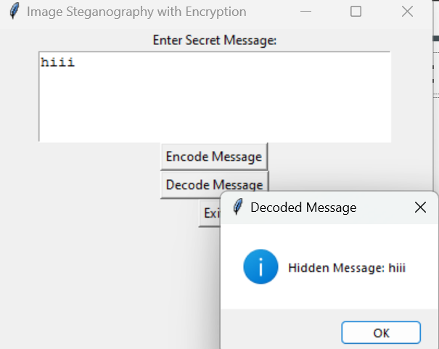
Results

Slide 13
Conclusion
Image steganography with encryption enhances data security.
Fernet ensures confidentiality and integrity.
Python and Tkinter make it easy to implement a GUI-based tool.
Combining encryption with steganography provides an extra layer of security.

Slide 14
GitHub Link
https://github.com/sanketrshinde19/-Steganography.git

Slide 15
Future scope(optional)
Implementing different encryption algorithms (AES, RSA).
Support for video and audio steganography.
Using deep learning for advanced steganalysis detection.

Slide 16
THANK YOU

